Slide 1

HPS
TEAM 8

Slide 2
ootd
#
HPS
TEAM 8

Slide 3
ootd
#
G
le

Slide 4
Gootdle

Slide 5
Smart dressing, zero messing
Gootdle

Slide 6
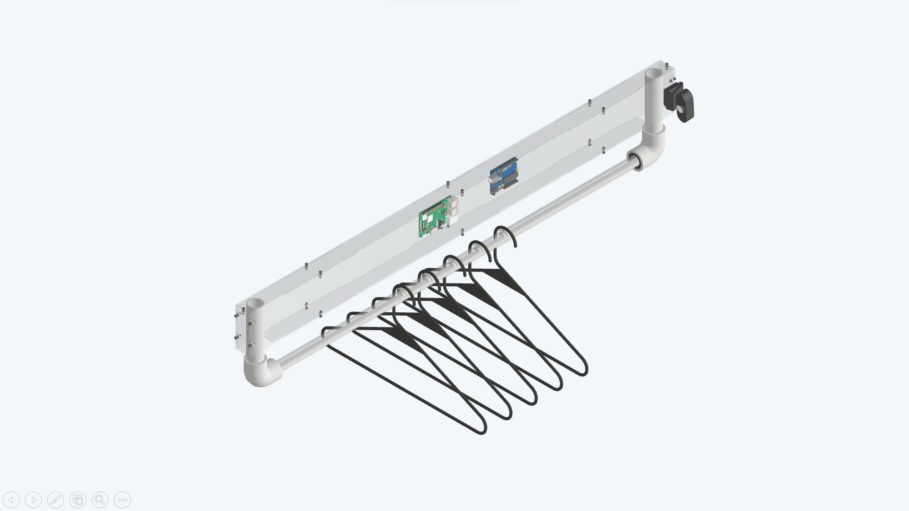

Gootdle

Slide 7
Camera
Raspberry pi
Used CV to identify what
cloth you are holding.
Communicated with
Backend server.
Arduino
Controlled LEDs and sended signals to Raspberry pi.
Force Sensing Elements
Located the clothes hung on clothing rail.
Gootdle

Slide 8
Camera
Raspberry pi
Used CV to identify what
cloth you are holding.
Communicated with
Backend server.
Arduino
Controlled LEDs and sended signals to Raspberry pi.
Force Sensing Elements
Located the clothes hung on clothing rail.
Gootdle

Slide 9
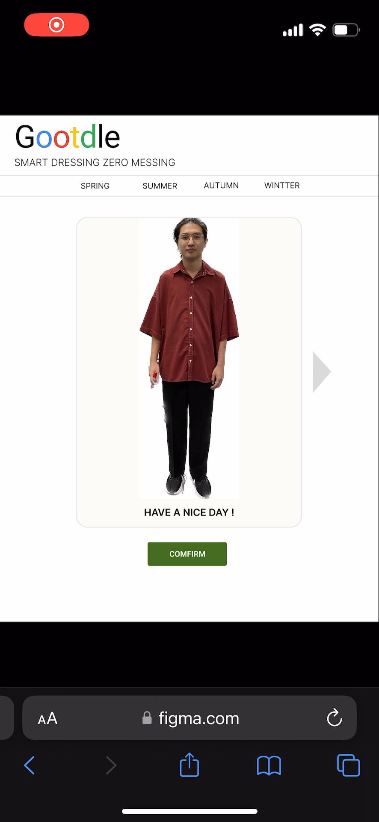
Clothes Recommandation
Find the perfect style for
you.
Gootdle

Slide 10
Clothes Recommandation
Find the perfect style for
you.
Gootdle

Slide 11
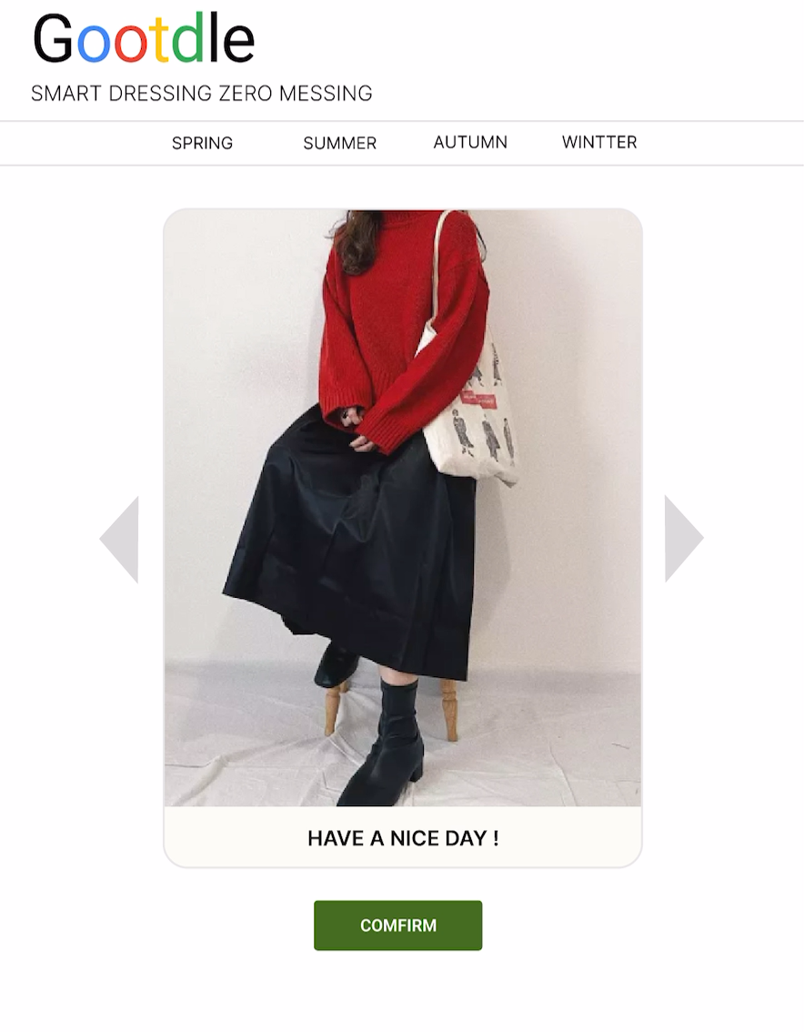
Clothes Recommandation
Find the perfect style for
you.
Gootdle

Slide 12
Gootdle

Slide 13
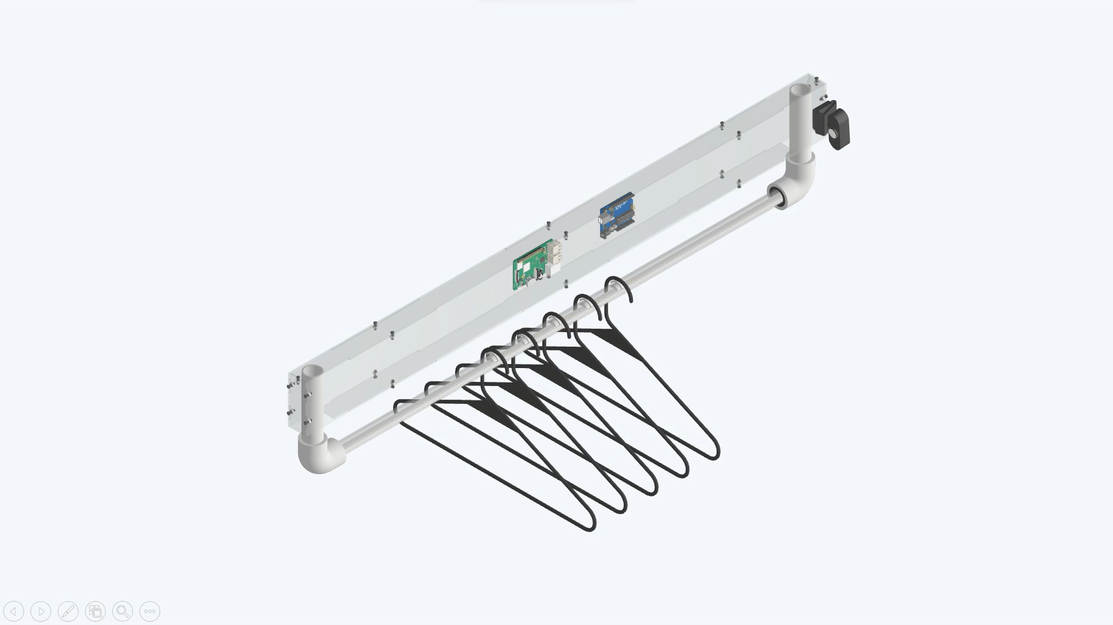
Gootdle

Slide 14
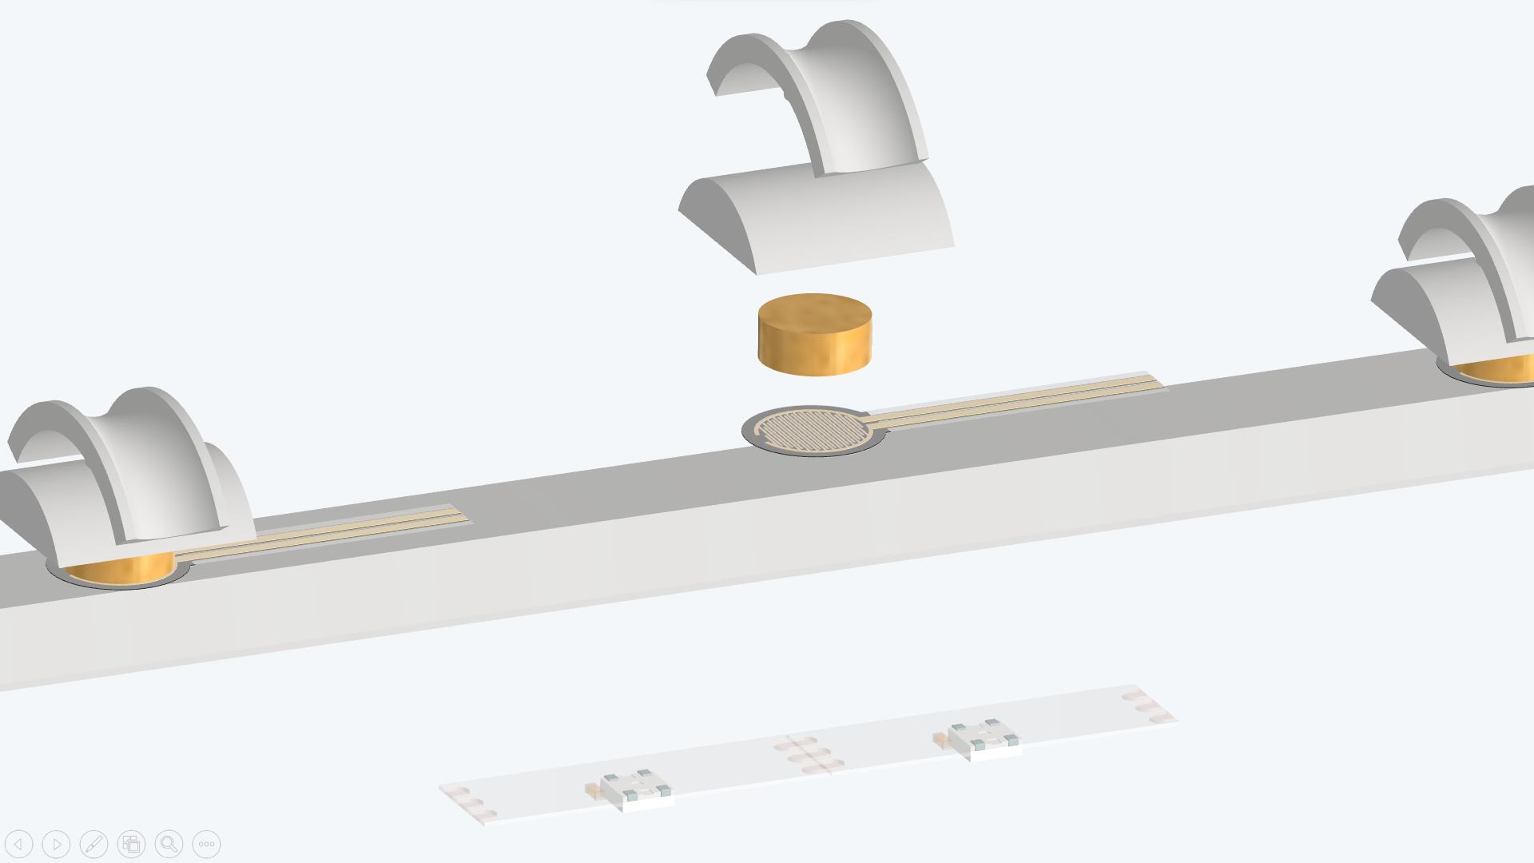
Gootdle

Slide 15
Slot
Hard Cushion
Soft Cushion
Force Sensor
WS2812 LED
Gootdle

Slide 16
Gootdle
Smart dressing, zero messing

